Slide 1
Capstone Project-2
Bike Sharing Demand Prediction Individual Member Kota Lakshmana Rao

Slide 2
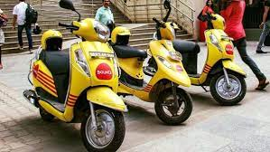
Content
Introduction
Problem Statement
points for discussion
Data Summary
Exploratory Data Analysis
Modelling Overview
Feature Importances
Challenges
Conclusion

Slide 3

Introduction
A bike rental or bike hire business rents out motorcycles for short periods of time, Usually for a few hours. Most rentals are provided by bike shops as a sideline to their main businesses of sales and service, but some shops specialize in rentals.
As with car rental, bicycle rental shops primarily serve people who do not have access to vehicle, typically travellers and particularly tourists.
Bike rental shops rent by the day or week as well as by the hour, and these provide an excellent opportunity for those who would like to avoid shipping their own bikes, but would like to do a multi-day bike tour of a particular area.

Slide 4
Problem Statement
Predicting bike count required at each hour for the stable supply of rental bikes to make the rental bike will available and accessible to the public at the right time as it lessens the waiting time.

Slide 5
points for Discussion
Data visualization of Rented bikes
exploring numerical variable
Data visualization frequent seasons
Data visualization of frequent Holiday count
Data visualization of frequent functional day counts
ddadfsdat

Slide 6
continue……
Data visualization of Rented bikes vs hour
Data visualization of Rented bikes vs Humidity
Data visualization of Rented bikes vs Wind_speed
Data visualization of Rented_bikes vs Rainfall
Data visualization of Rented_bikes vs Snow_fall
Heat map before multicollinear
Heat map after multi collinear
Linear regression,lasso regression, Ridge regression, Random Forest Regressor, Gradient boosting Regressor, default XGboost, XGboost with Grid_search_cv, CAT boost Regressor
Training model data summary
Testing model data summary
Conclusion

Slide 7
Data Summary
Date : year-month-day
Rented Bike count - Count of bikes rented at each hour
Hour - Hour of he day
Temperature-Temperature in Celsius
Humidity - %
Wind speed - m/s
Visibility - 10m
Dew point temperature - Celsius
Solar radiation - MJ/m2
Rainfall - mm
Snowfall – cm
Seasons - Winter, Spring, Summer, Autumn
Holiday - Holiday/No holiday
Functional Day - NoFunc(Non Functional Hours), Fun(Functional hours)

Slide 8
Data Analysis Steps
Imported Libraries: In this part, we had imported require libraries numpy, pandas,matplotlib,seaborn,to perform Exploratory Data Analysis and for prediction we imported Sklearn library
Descriptive Statistics: In this part, we start by looking at descriptive statistic parameters for the dataset. We will use describe() this told mean, median, standard deviation etc
Missing Value Imputation: We will now check for missing values in our dataset. after checking not existed any missing values ,In case there is any missing entries, we will impute them with appropriate values
Graphical Representation: We will start with Univariate Analysis. and end with bivariate analysis for graphical presentation

Slide 9
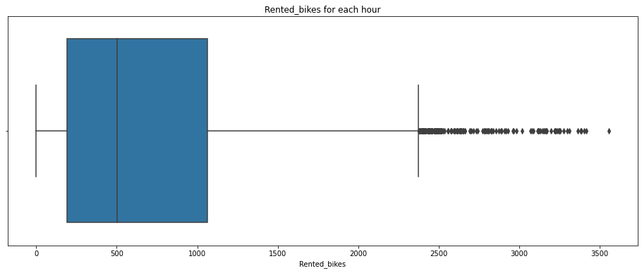
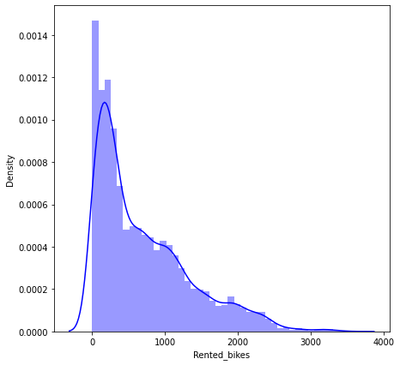
Exploratory Data Analysis Rented Bikes
From the above we can conclude that maximum rented bikes are 3556,minimum rented bikes are zero also existed

Slide 10
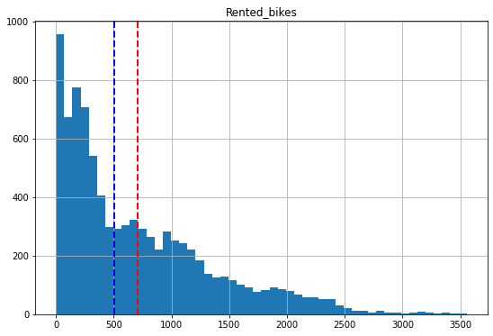
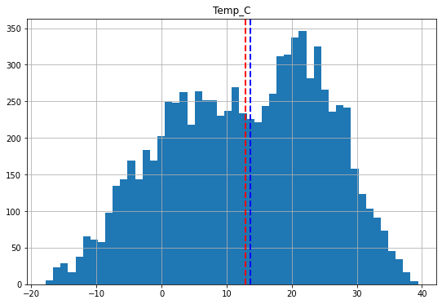
Exploring Numerical Variables
The above graph is about the exploring numerical variables for rented bikes and temp_c mean is red line and blue line is median

Slide 11
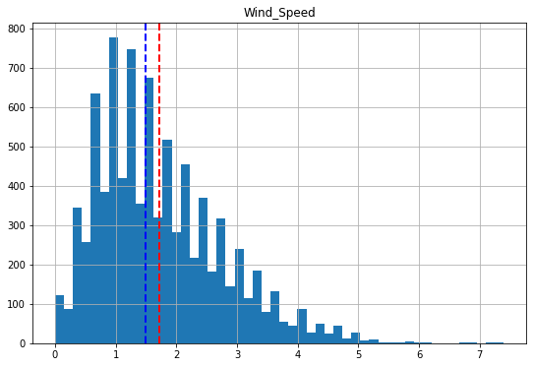
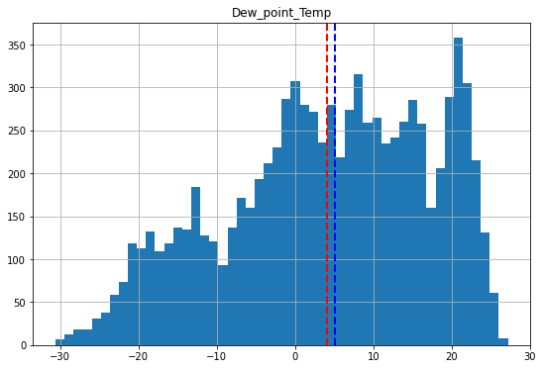
The above graph is about the exploring numerical variables for Wind_speed and dew_point_temp. mean is red line and median is blue line

Slide 12
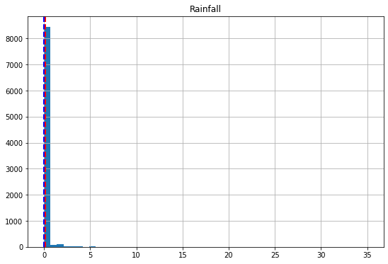
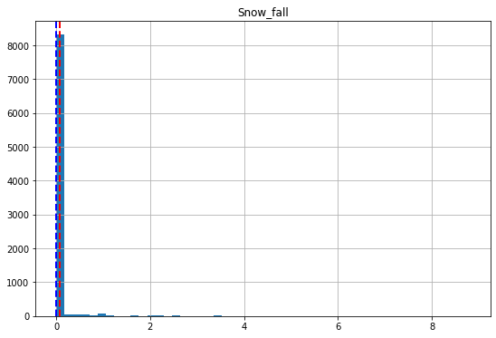
The above graph is about the exploring numerical variables for Rainfall and snow_fall mean is red line and median is blue line

Slide 13
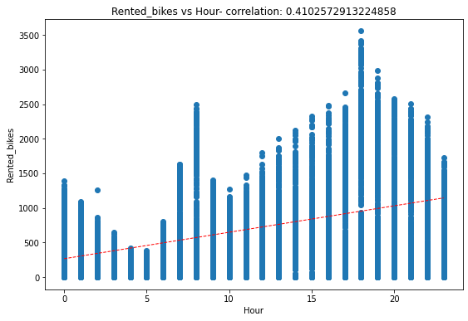
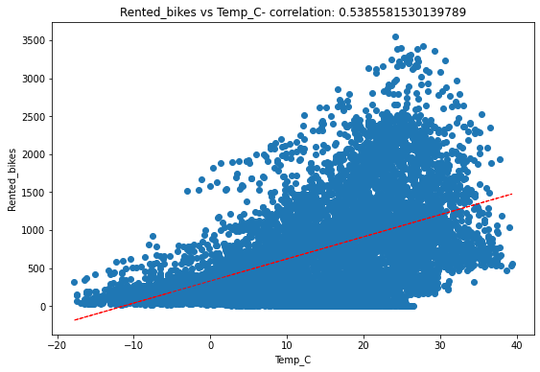
The rented bikes vs hour correlation is 0.4102572913224858 and rented bikes vs temp_c correlation is 0.5385581530139789.

Slide 14
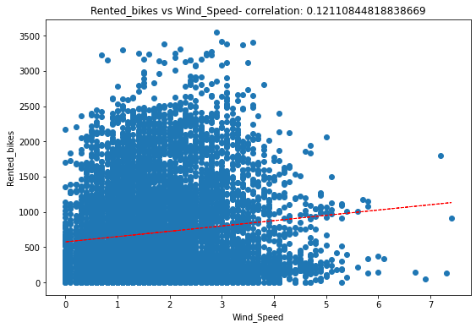
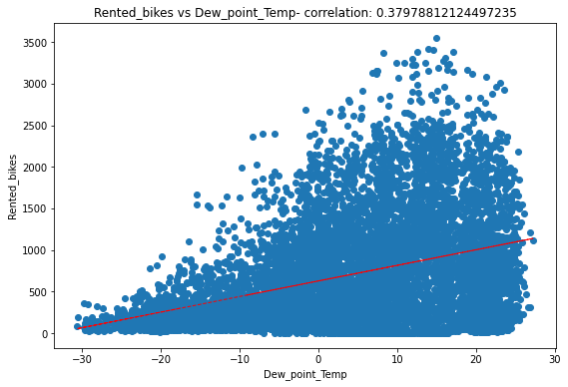
The rented_bikes vs wind_speed correlation is 0.12110844818838669 and recent_bikes vs dew_point_temp correlation is 0.37978812124497235.

Slide 15
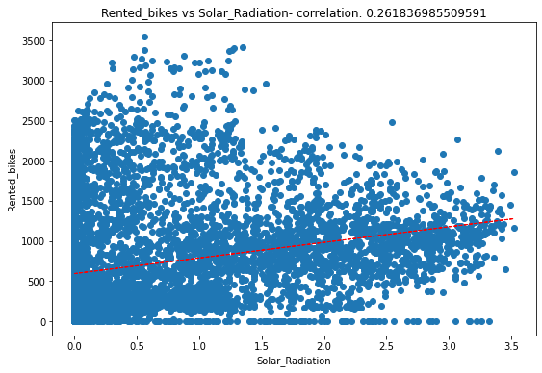
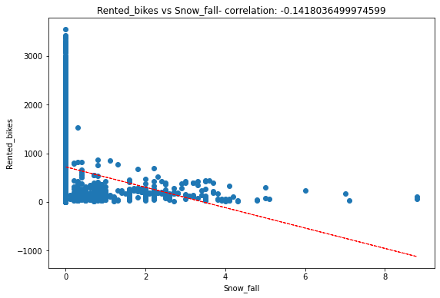
The rented bikes vs solar_radiation correlation 0.26183698550951 and rented_bikes vs snow_fall correlation is -0.1418036499974599.

Slide 16
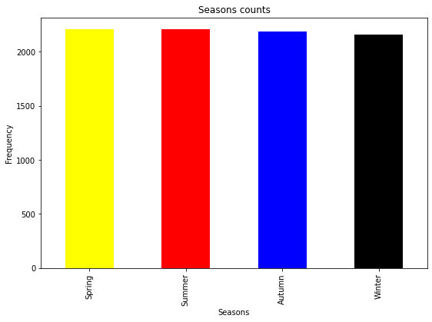
Season Counts
From the above data we can conclude that Summer 2208,Spring 2208,Autumn 2184,Winter 2160

Slide 17
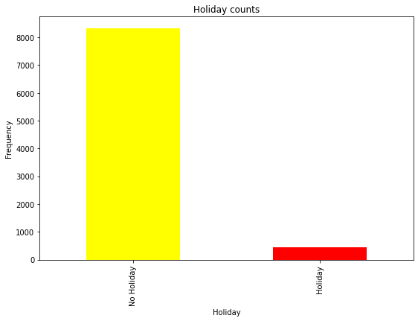
Holiday Counts
From the above data we can conclude No Holiday 8328,Holiday 432

Slide 18
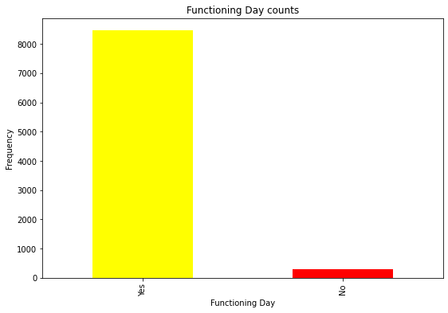
Functioning Day Counts
From the above data we conclude Yes 8465,No 295

Slide 19
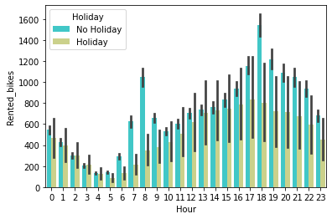
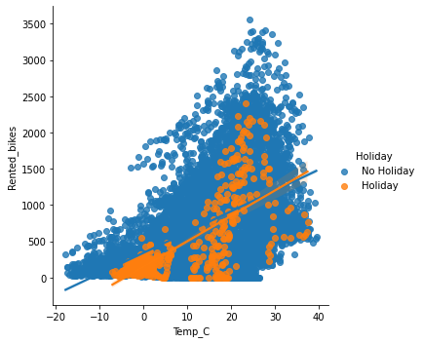
Rented_Bikes vs Hour
From the above conclude that Rented_bikes are took in Non-Holidays maximum bikes taken is 3,556 in 1 hour and Bikes not took by any one in 295 hours and the rented bikes worked when temperature above 20 centigrades in Non-Holiday days

Slide 20
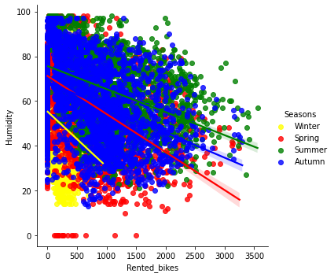
Rented_bikes vs Humidity
From the above data we can conclude that most of the rented bikes are taken when the Humidity is higher 20% ,all seasons have equal demand for Rental_bikes

Slide 21
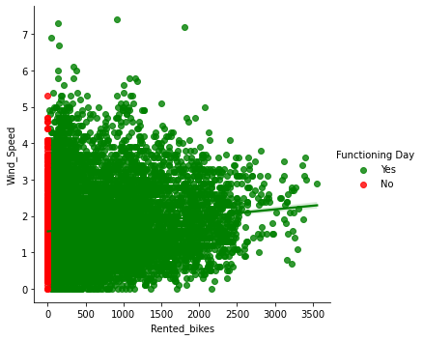
Rented_bikes vs Wind_Speed
From the above data we can conclude that Ir resptive of Wind_speed all working days customers were taking bikes for Rent.

Slide 22
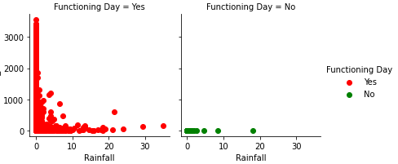
Rented_bikes vs Rainfall
From the above data we can conclude that In functional working day when ever Rainfall reaches 10mm then rented_bikes reducing and when Rainfall is high i.e more than 20mm renting bikes done rarely.

Slide 23
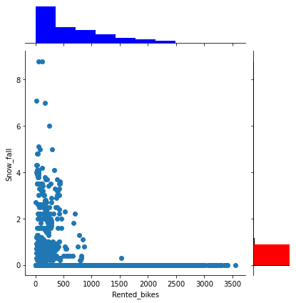
Rented_bikes vs Snow_fall
From the above data we can conclude that we ever snow_fall is zero the Rental_bikes high peack and when ever snow_fall is four or more then taking rental bikes less and sometimes No one taking rental_bikes.

Slide 24
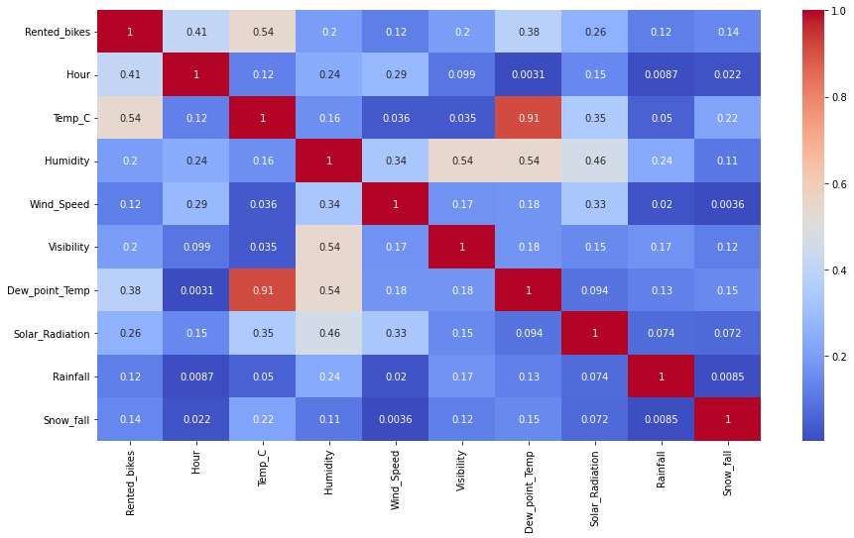
Heatmap Correlation
The above heatmap shows correlation relationship between any two columns,some part
of data having highly correlated,some part of data having negative correlated and
some data have zero correlated

Slide 25
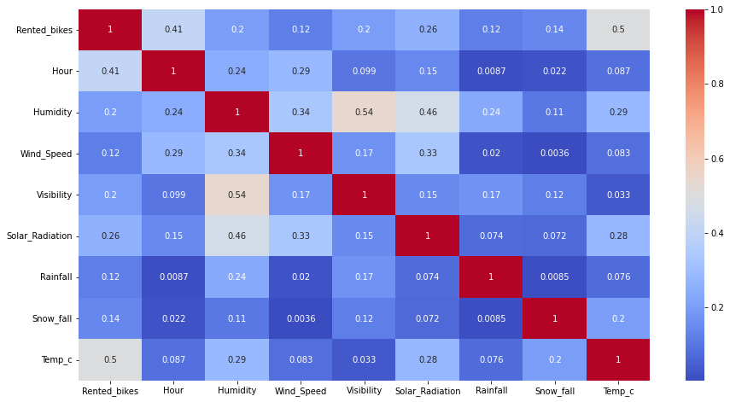
HEAT map after multicollinear
Collinear between Temperature and Dowe_point_temperature so this points have been removed and replaced with weights based temp_c.This heatmap is about after removing temp_c.

Slide 26
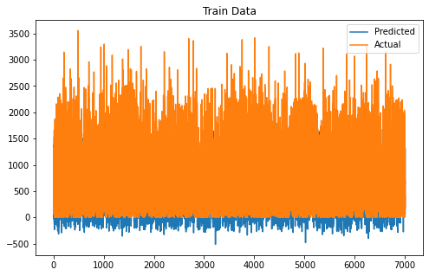
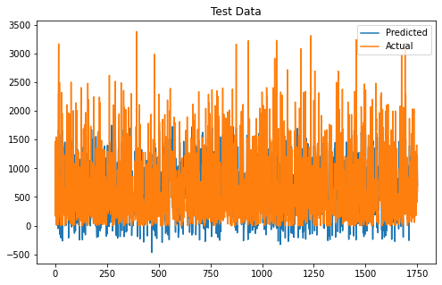
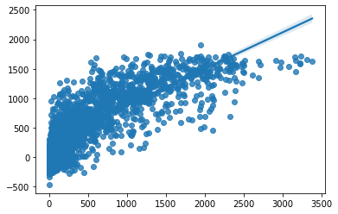
Linear Regression
From the training data prediction and actual values comparison it’s r2 accuracy is approx 60%,and
testing data predicted achieved values and actual values comparison it’s r2 accuracy is approx 61%

Slide 27



Lasso Regression
From the training data prediction and actual values comparison it’s r2 accuracy is approx 60%,and
testing data predicted achieved values and actual values comparison it’s r2 accuracy is approx 61%

Slide 28
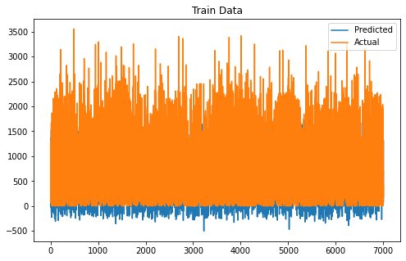

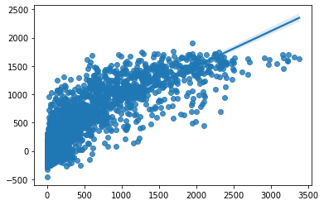
Ridge Regression
From the training data prediction and actual values comparison it’s r2 accuracy is approx 60%,and
testing data predicted achieved values and actual values comparison it’s r2 accuracy is approx 61%

Slide 29
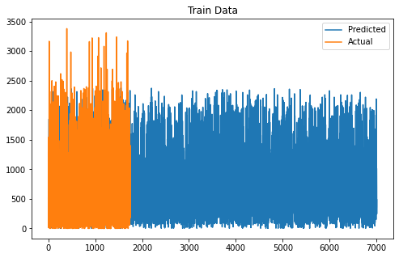
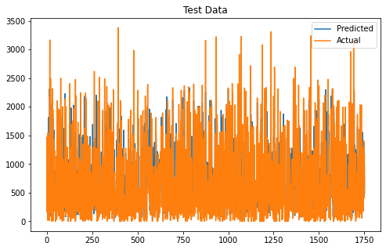
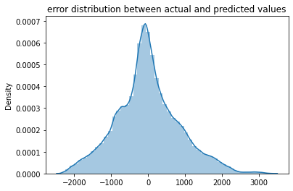
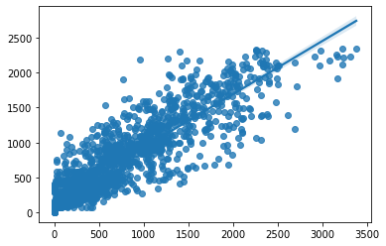
Random Forest Regressor
From the training data prediction and actual values comparison it’s r2 accuracy is approx 82%,and
testing data predicted achieved values and actual values comparison it’s r2 accuracy is approx 79%

Slide 30
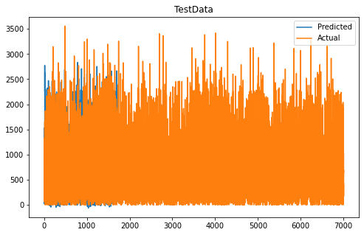
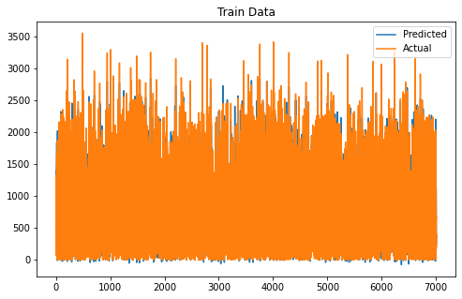
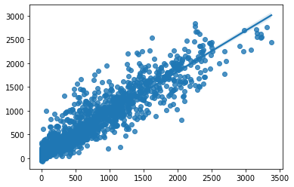
Gradient boosting regressor
From the training data prediction and actual values comparison it’s r2 accuracy is approx 94%,and
testing data predicted achieved values and actual values comparison it’s r2 accuracy is approx 86%
.

Slide 31
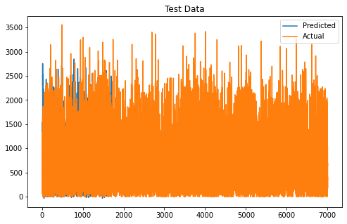
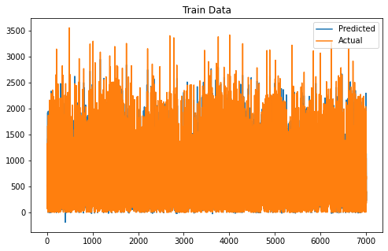
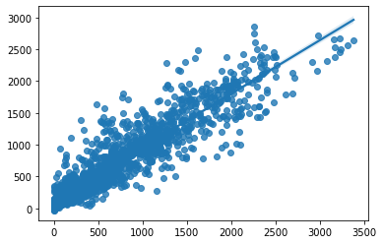
XGBOOST
From the training data prediction and actual values comparison it’s r2 accuracy is approx 93%,and
testing data predicted achieved values and actual values comparison it’s r2 accuracy is approx 86%

Slide 32
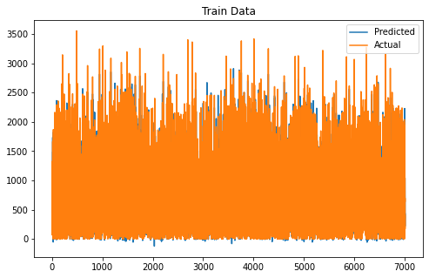

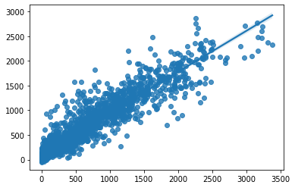
Grid search cv on XGboost
From the training data prediction and actual values comparison it’s r2 accuracy is approx 94%,and
testing data predicted achieved values and actual values comparison it’s r2 accuracy is approx 86%

Slide 33
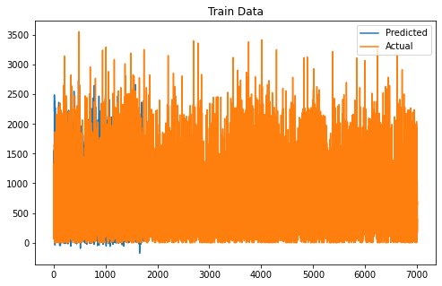

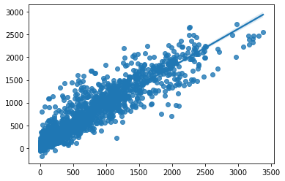
CAT Boost Regressor
From the training data prediction and actual values comparison it’s r2 accuracy is approx 88%,and
testing data predicted achieved values and actual values comparison it’s r2 accuracy is approx 84%
.

Slide 34
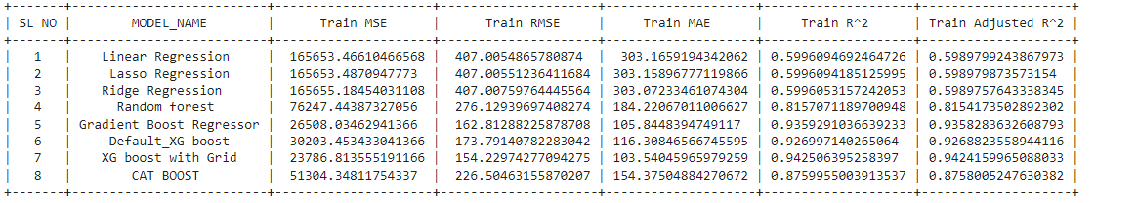
Model Summary for Train Data

Slide 35
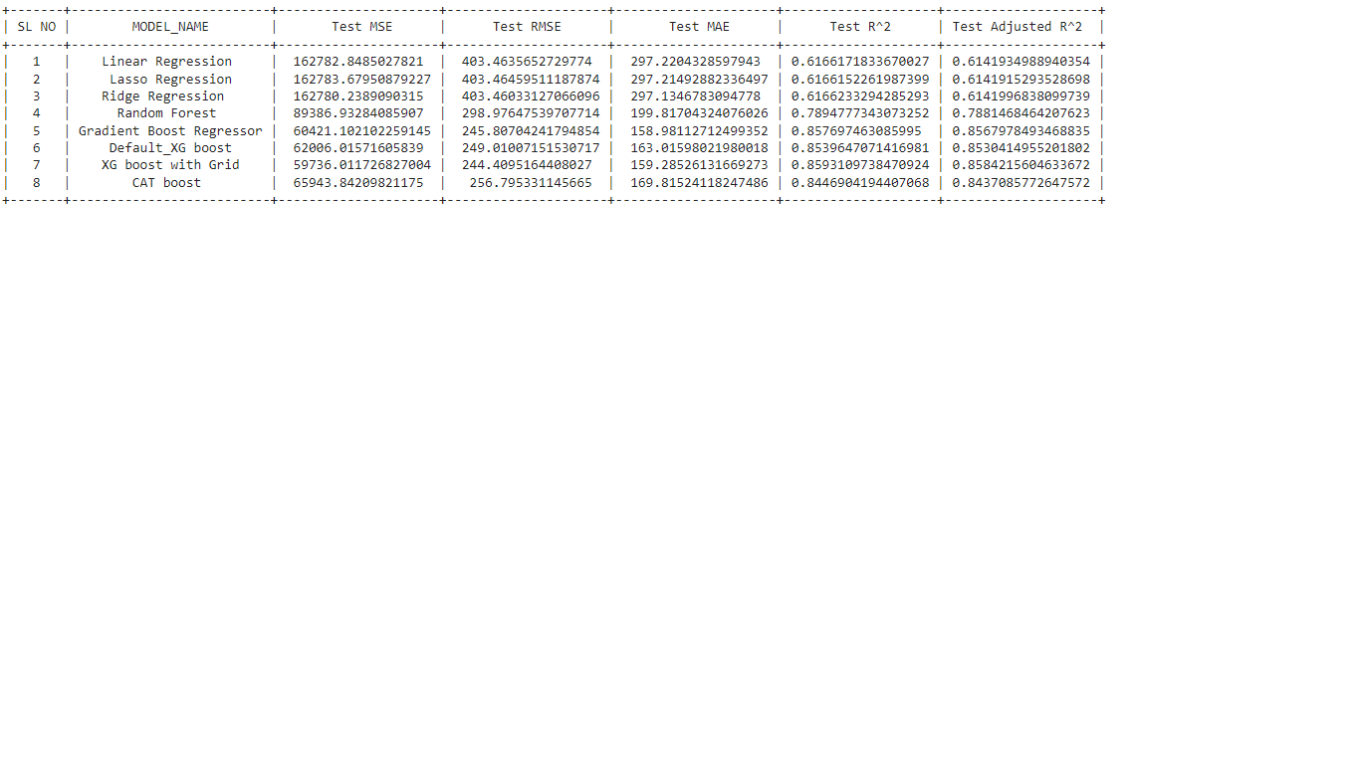
Model Summary for Test Data

Slide 36
Conclusion
We used different type of regression algorithms to train our model like, Linear Regression, Regularized linear regression (Ridge and Lasso),Random Forest Regressor, Gradient boosting Regressor, default XGboost regressor. and Also we tuned the parameters of Random forest regressor and XGboost regressor Out of them XGboost with Grid search CV (tuned hyperparameters gave) the best result.
MSE is approx 59734,
RMSE IS approx 245,
MAE is approx 159,
R2 is approx 86%,
Adj R2 approx 86%

